Slide 1
Introduction to Carriage of Goods by Sea: Bills of Lading
Dr Mukarrum Ahmed, PhD (Aberdeen), Barrister (Lincoln’s Inn) and Lecturer in Business Law
Notes:
LANCASTER UNIVERSITY POWERPOINT TEMPLATES
These PowerPoint templates are for use by all Lancaster University staff. Please see below for further information regarding the use of these templates. Should you have any further queries, please contact the marketing team via marketing-services@lancaster.ac.uk
Template slide 3: Insert a new slide
If you need to insert a new slide, from the ‘home’ toolbar, click on ‘new slide’ and select from the templates the style you require from the dropdown box.
Template slide 4: Typing new text and copying text from another document
New text should be typed over the text in the appropriate template. Copy and pasting text from another document will result in changing the style of the typography and layout. This is unavoidable as it is part of the Microsoft software. We appreciate that in sometimes you will need to copy text from another document into this template. Once you have pasted the existing text into the template, you will need to change the formatting so that they typefaces, sizes, colour, line spacing and alignment are consistent with the rest of the template.
Template slide 5: Inserting images
There are three choices of templates with images already inserted. Please use the template with the relevant image size and positioning. To insert an image, please go to ‘insert’ then ‘picture’ and find your image, highlight it and ‘insert’. Resize the image and position as per the example template.
Template slide 6: Text boxes
If a text box is deleted, either insert a new slide (using the appropriate template) or go to another slide and copy a text box. To select a text box for copying, please click on the outer edge of the text box so that the line goes solid (not dashed). Right click your mouse and select ‘copy’, then go back and ‘paste’ it into the slide where the text box is missing which should paste into the correct position on the slide.
Template slide 7: Other information
Typefaces, sizes and colours All copy is Calibri.
Slide title copy throughout:
Size: 36 point
Colour Lancaster University red: (RGB) R: 181 G: 18 B: 27 (recent colours on PowerPoint) Small copy on first and last slide: Size: 16 point Colour grey: (RGB) R: 102 G: 102 B: 102 (recent colours on PowerPoint)
Sub-headings: Size: 24 point – italics Colour grey: (RGB) R: 102 G: 102 B: 102 (recent colours on PowerPoint)
Bullets copy and body copy: Size: 24 point (see below for a further option) Colour grey: (RGB) R: 102 G: 102 B: 102 (recent colours on PowerPoint)
It isn’t advisable to have too much text on a slide, however on rare occasions it may be necessary, therefore there is a slide using 20 point bullet pointed text.
Line spacing and alignment
Single line spacing (apart from the main headings which is ‘exactly 35 point’)
All text is aligned left
Slide title options
There are two options for titles on the slides – one line or two lines for longer titles. Ideally, the one line title should be used, however on rare occasions a two line title maybe needed.

Slide 2
In this Section
Asymmetrical bargaining power of the carrier and the shipper in carriage of goods by sea contracts in the 19th century
Roadmap of international conventions and legislation
Key terminology and concepts in the law of carriage of goods by sea

Slide 3
Introduction
In the 19th century contracts for the carriage of goods by sea presented an asymmetrical nature due to the imbalance in the bargaining power of the ship owner (‘carrier’) and the cargo owner (‘shipper’).
The carrier could unilaterally allocate risk to minimise his liability – laissez faire approach to commerce and contract law.
Therefore, there was a need to limit the power of the carrier and redress the balance of power in favour of the shipper.

Slide 4
Timeline of International Conventions and Legislation
Harter Act 1893 (US).
International Convention for the Unification of Certain Rules of Law Relating to Bills of Lading, 1924 (Hague Rules) - First attempt at harmonised rules – Implemented into UK law by the Carriage of Goods by Sea Act 1924.
Protocol to amend Hague Rules 1968 (Hague-Visby Rules) - Amended the original Hague Rules – Implemented into UK law by the Carriage of Goods by Sea Act 1971.
United Nations Convention on the Carriage of Goods by Sea 1978 (Hamburg Rules) - These rules have not been a great success.
Carriage of Goods by Sea Act 1992. - 2009 United Nations Convention on Contracts for the International Carriage of Goods Wholly or Partly by Sea (Rotterdam Rules) - Latest attempt at harmonised rules.

Slide 5
Contracts for the Carriage of Goods by Sea: Terminology and Concepts
Charterparty – contract of carriage of goods by sea between the ‘Ship owner’ and ‘Charterer’.
Voyage Charterparty
Time Charterparty
Bareboat (demise) Charterparty – Crew is supplied by the charterer – Do not constitute contracts for the carriage of goods by sea at all.
Contracts of carriage cannot be viewed in isolation from contracts for the sale of goods and the provision of finance against documents.
Our primary focus is on contracts for the carriage of goods by sea evidenced by a bill of lading.
Bill of lading: The shipper enters into a contract of carriage of goods by sea with the carrier. When the shipper delivers the goods to the carrier, the carrier issues a bill of lading. At this point the bill of lading serves as a receipt of goods, that the carrier has the possession of the goods and as evidence of the contract of carriage.

Slide 6
In this Section
Real example of a bill of lading
The bill of lading and the charterparty
The bill of lading and the sea waybill
The three functions of a bill of lading

Slide 7
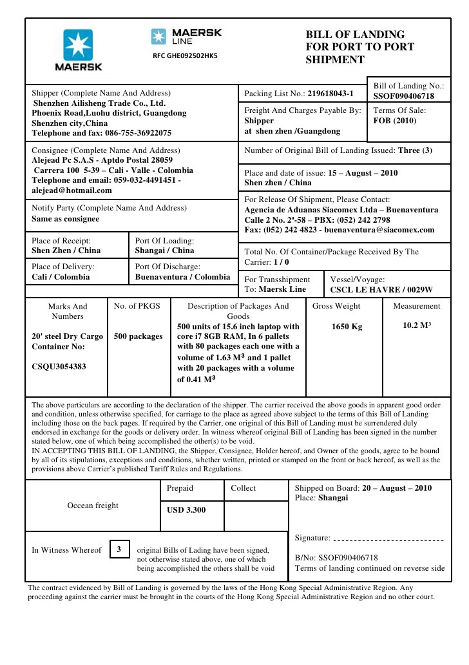
Example of a Bill of Lading

Slide 8
Bill of Lading and Charterparty
Bill of lading v Charterparty
A charterparty is a contract of carriage
but
a bill of lading is:
a document of title,
a receipt of the goods and their condition
and is evidence of a contract of carriage.

Slide 9
Bill of Lading and Sea Waybill
Bill of lading v Sea Waybill
The sea waybill is not a document of title and it is not a negotiable instrument entitling the holder to possession.
It acts as a receipt and evidence of a contract of carriage.
Presentation of sea waybill to the master to obtain possession of the goods is not necessary.
The sea waybill can be reproduced.
The sea waybill is still subject to the Hague-Visby Rules.
Bill of lading ‘to order’ is negotiable and is required to obtain possession of the goods.
A straight bill of lading is not negotiable – but required to obtain possession.

Slide 10
The Three Functions of a Bill of Lading
A bill of lading serves three significant functions:
It acts as a receipt for the goods shipped.
It acts as evidence of the contract of carriage between shipper and carrier (it only acts as evidence but it is not the contract itself)
It acts as a document entitling the holder to possession of the goods (a form of constructive possession, meaning the shipper can transfer the bill of lading to the purchaser of goods)

Slide 11
In this Section
The bill of lading as a receipt

Slide 12
Bill of lading as a Receipt – Issued by who?
Delivery of goods (container) to port.
Goods are loaded onto the ship.
The ship’s responsibility is from rail to rail.
The burden passes to the ship when the goods are loaded onto the ship.
A mate’s receipt is issued which entitles the shipper to be issued the bill of lading.
Who has issued the bill of lading? Who is the carrier? Is it the time charterer or the demise charterer or a sub-charterer thereof or the ship owner?
Once the bill of lading has been signed it acts as a receipt and records the condition of the goods.

Slide 13
Bill of lading as a receipt – Clean Bill of lading
Shipped on board bill of lading: the goods are on board
Received for shipment bill of lading: receipt of the goods, does not necessarily mean that goods are loaded on the ship
A bill of lading contains evidence of:
Quantity i.e. how many containers, packages, pieces or weight
Quality
Condition
“Apparent good order and condition” (means the container looks good, only external observation of condition and number), the master will issue a clean bill of lading.
“Condition unknown” deemed to apply to internal condition
“STC” said to contain

Slide 14
Bill of lading as a receipt – Claused Bill of lading
Clausing of bill of lading means that a master or agent exercising reasonable judgment and acting honestly may ‘clause’ a bill of lading, it reflects an accurate statement of apparent order and condition. Shipper is deemed to guarantee the information furnished by it to the carrier and required to indemnify carrier for losses resulting from inaccuracies.
Carrier bears onus of condition reporting, they may issue a clean bill of lading when disagreement arises between shipper and carrier as to condition of goods if shipper provides indemnity against liability.
Article III(4) of the Hague-Visby Rules.
Clean bill of lading is prima facie proof as to condition against shipper.
Clean bill of lading is conclusive proof when transferred to a third party in good faith (consignee or indorsee) and carrier may be estopped from denying condition represented.
Compania Naviera Vascongada v Churchill [1906] 1 KB 237.
Cf. Position in common law under Grant v. Norway (1851) 10 CB 665.

Slide 15
Bill of lading as a receipt – “Shipper’s load, stow and count”
“Shipper’s load, stow and count” or “SLAC”
Marbig Rexel Pty Ltd v ABC Container Line NV (The TNT Express) [1992] 2 Lloyd’s Rep 636.
Held that the carrier could not be estopped from denying that goods were in apparent good order and condition, if you did say shipper’s load, stow and count or SLAC, the carrier cannot be estopped from arguing that although they said SLAC, in fact these goods were damaged when delivered to the carrier.
Claimant endorsee required to adduce evidence of good order and condition, claimant bears the burden of proof.
i.e. ‘SLAC’ negates any representation of condition of contents of containers (i.e. no prima facie evidence).

Slide 16
Bill of lading as a receipt – Quantity or Weight
Receipt as to quantity or weight
Prima facie evidence against shipper.
Carrier can adduce evidence that quantity and weight not as reflected in bill of lading.
Against third party (consignee or indorsee) acting in good faith, Carrier cannot adduce evidence to contrary even if third party did not rely on bill of lading to detriment.

Slide 17
Bill of lading as a receipt – Leading Marks
Receipt as to leading marks
Identifications marks, such as container number.
Marks of identity (what the commercial character is) and marks of identification (such as numbering).

Slide 18
In this Section
The bill of lading as a document of title
The bill of lading as evidence of the contract of carriage

Slide 19
Bill of lading as Document of Title
More accurately, it amounts to constructive possession, and thus be a pre-requisite for the passing of title.
May be an order or bearer bill, with the latter “to order” allowing endorsement.
Delivery by carrier in good faith to holder of bill of lading discharges the carrier of liability in the goods.
Carrier liable for misdelivery.
Master’s obligation is to give the goods to the person who has the bill of lading in their possession.
Straight bills of lading – The Rafaela S [2005] UKHL 11; APL v Voss [2002] 2 Lloyd’s Rep 707.

Slide 20
Bill of lading as Evidence of the Contract of Carriage
Bill of lading is EVIDENCE of contract of carriage (stage of being reduced to writing)
Therefore, not conclusive evidence of contractual terms.
Usually, though, bill of lading treated as contract.
Third parties: Leduc v Ward (1888) 20 QBD 475.
H, HV, Hamburg or Rotterdam Rules incorporated usually via a Clause Paramount.

Slide 21
Revision
Asymmetry in the bargaining power of the carrier and the shipper.
International Conventions on the rights and liabilities of carriers and shippers in carriage contracts – Hague-Visby Rules applicable in the UK.
How does a bill of lading differ from a charterparty and a sea waybill?
Three Functions of bills of lading

Slide 22
Next up: The Hague-Visby Rules

